Slide 1
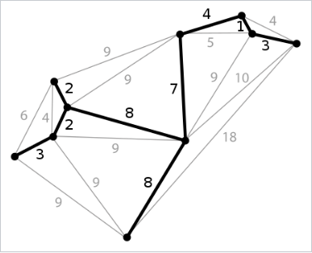
Minimum spanning tree
1
In this presentation we tell you, what is MST in graph and show you some examples.
Make the popcorn and let’s do it!
Created by FHD teams

Slide 2
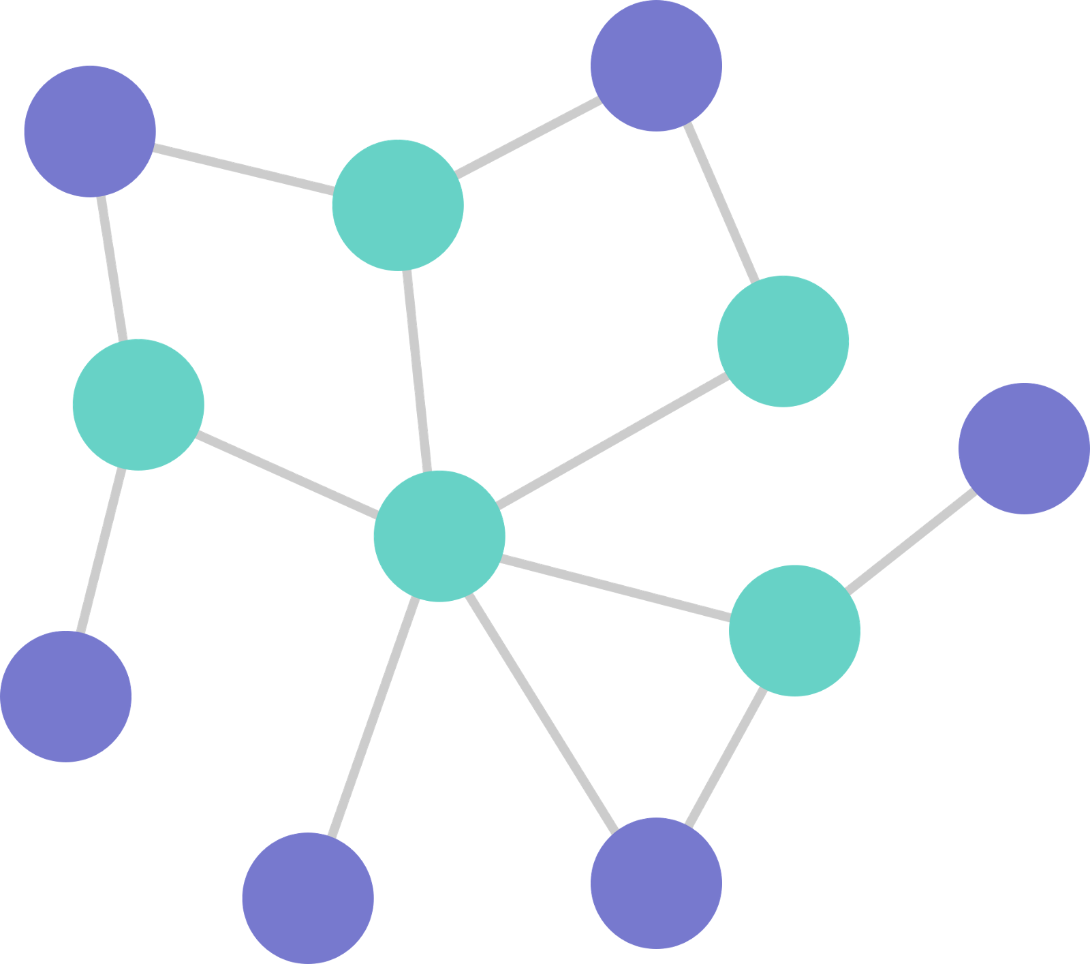
Graph WHAT IS IT?
If we ask the Internet, we find out that the graph is a non-linear data structure consisting of nodes and edges.
The nodes are sometimes also referred to as vertices and the edges are lines or arcs that connect any two nodes in the graph.
1
2

Slide 3
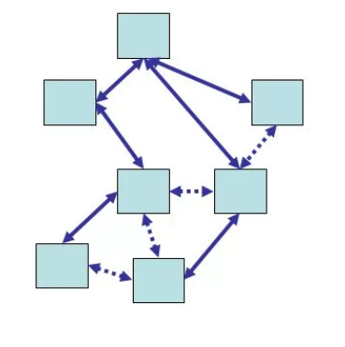
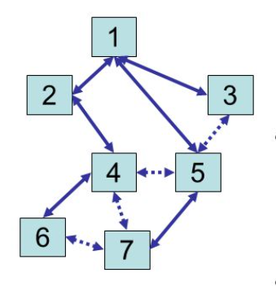
Spanning tree
Given an undirected and connected graph G=(V,E), a spanning tree of the graph G is a tree that spans G (that is, it includes every vertex of G) and is a subgraph of G (every edge in the tree belongs to G)

Slide 4
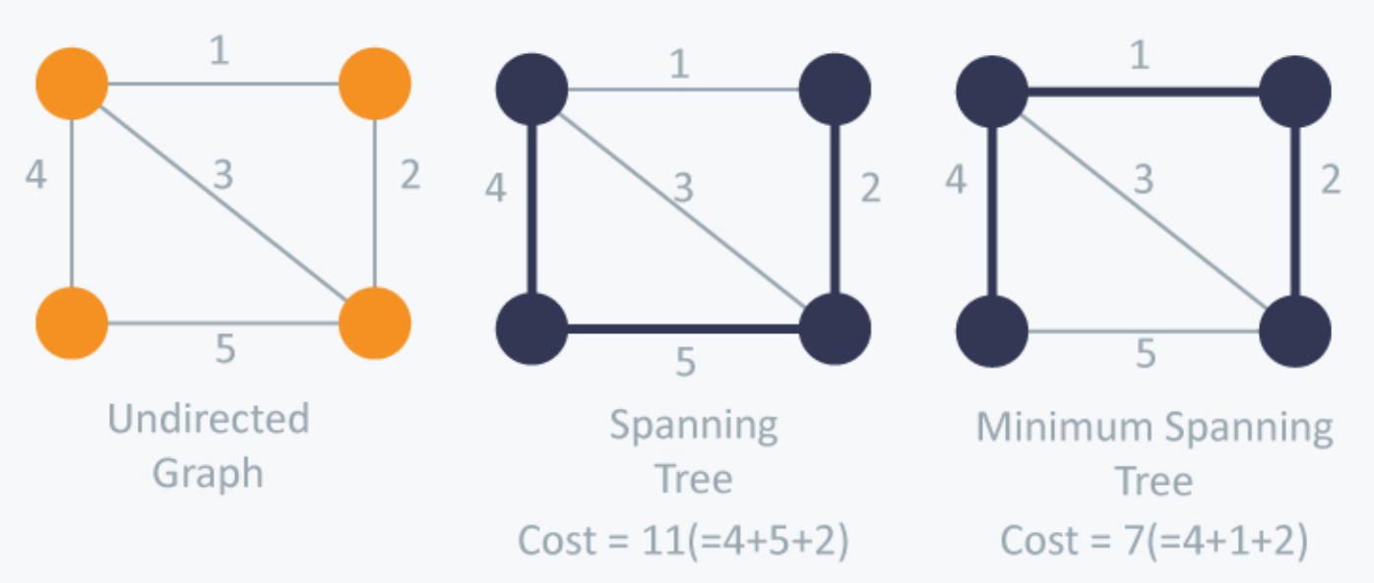
Minimum spanning tree
A minimum spanning tree (MST) or minimum weight spanning tree is a subset of the edges of a connected, edge-weighted undirected graph that connects all the vertices together, without any cycles and with the minimum possible total edge weight. That is, it is a spanning tree whose sum of edge weights is as small as possible.

Slide 5
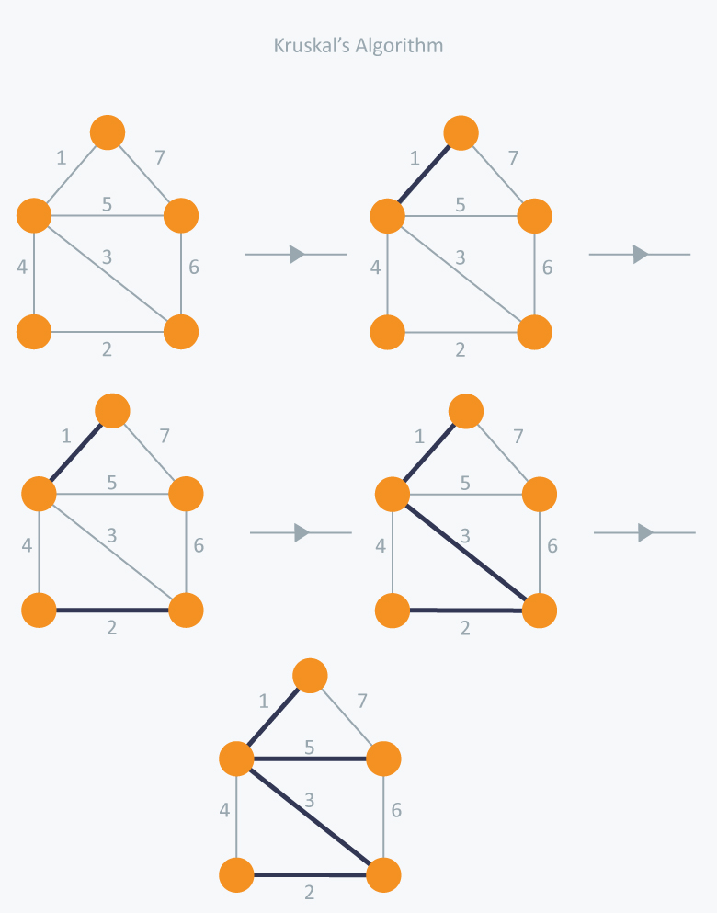
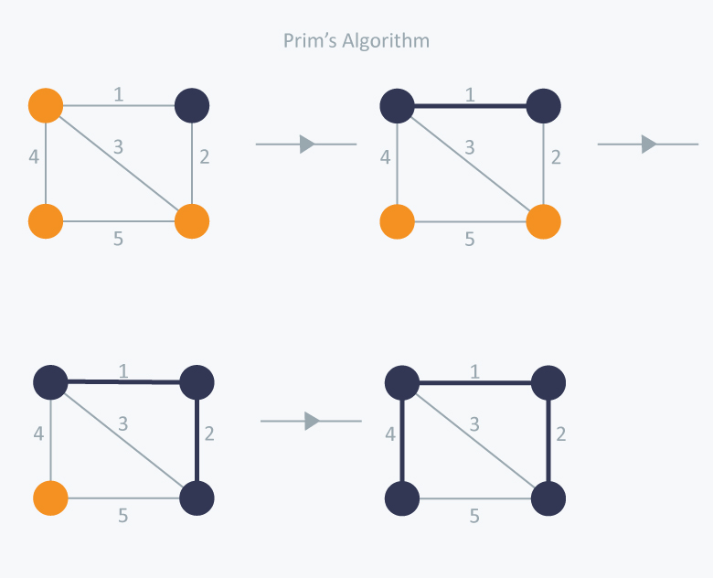
There are two famous algorithms for finding the Minimum Spanning Tree:
1
2
Kruskal’s Algorithm
Prim’s Algorithm

Slide 6
Kruskal
Kruskal is a greedy approach which emphasizes on the fact that we must include only those (vertices-1) edges only in our MST which have minimum weight amongst all the edges, keeping in mind that we do not include such edge that creates a cycle in MST being constructed.

Slide 7
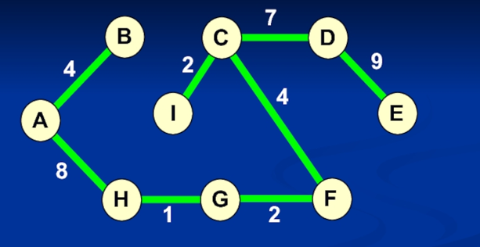
How it works?
1
We keep a list of all the edges sorted in an increasing order according to their weights.
Take an edge from the list, check if it creates a cycle in the MST being constructed
if it does not create any cycle, then we include the edge in our MST being constructed.
if it creates a cycle, then we skip the current edge and move on to the next edge in the sorted list.
We need to repeat the same process again until we have(vertices - 1 ) edges in the final Minimum Spanning Tree.
2
3
4
5

Slide 8
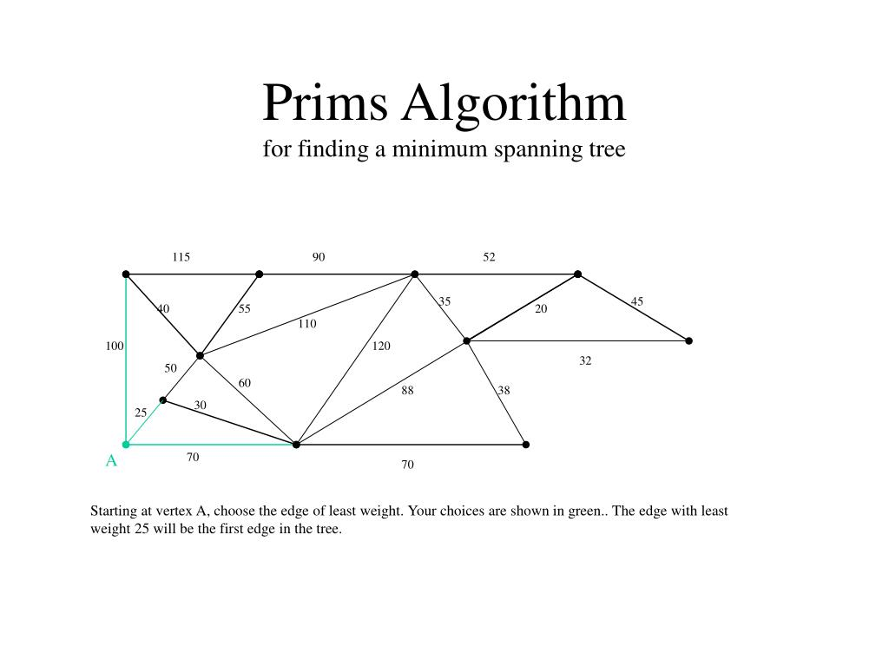
Prim’s Minimum Spanning Tree
Like Kruskal’s algorithm, Prim’s algorithm is also a Greedy algorithm. It starts with an empty spanning tree. The idea is to maintain two sets of vertices. The first set contains the vertices already included in the MST, the other set contains the vertices not yet included. At every step, it considers all the edges that connect the two sets, and picks the minimum weight edge from these edges. After picking the edge, it moves the other endpoint of the edge to the set containing MST.

Slide 9
How does Prim’s Algorithm Work?
The idea behind Prim’s algorithm is simple, a spanning tree means all vertices must be connected. So the two disjoint subsets (discussed above) of vertices must be connected to make a Spanning Tree. And they must be connected with the minimum weight edge to make it a Minimum Spanning Tree.

Slide 10
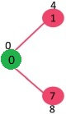
Example
The set mstSet is initially empty and keys assigned to vertices are {0, INF, INF, INF, INF, INF, INF, INF} where INF indicates infinite. Now pick the vertex with the minimum key value. The vertex 0 is picked, include it in mstSet. So mstSet becomes {0}. After including to mstSet, update key values of adjacent vertices. Adjacent vertices of 0 are 1 and 7. The key values of 1 and 7 are updated as 4 and 8. Following subgraph shows vertices and their key values, only the vertices with finite key values are shown. The vertices included in MST are shown in green color.

Slide 11
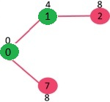
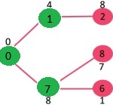
Pick the vertex with minimum key value and not already included in MST (not in mstSET). The vertex 1 is picked and added to mstSet. So mstSet now becomes {0, 1}. Update the key values of adjacent vertices of 1. The key value of vertex 2 becomes 8.
Pick the vertex with minimum key value and not already included in MST (not in mstSET). We can either pick vertex 7 or vertex 2, let vertex 7 is picked. So mstSet now becomes {0, 1, 7}. Update the key values of adjacent vertices of 7. The key value of vertex 6 and 8 becomes finite (1 and 7 respectively).
1.
2.

Slide 12
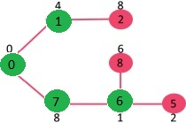
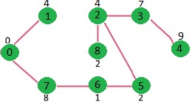
3.
3. Pick the vertex with minimum key value and not already included in MST (not in mstSET). Vertex 6 is picked. So mstSet now becomes {0, 1, 7, 6}. Update the key values of adjacent vertices of 6. The key value of vertex 5 and 8 are updated.
4. We repeat the above steps until mstSet includes all vertices of given graph. Finally, we get the following graph.
4.

Slide 13

LET’S START CODE
13

